Slide 1



Name of Project
Water Quality Prediction - RMS AICTE Virtual Internship – June 2025 Sponsored by: Shell By: Akshitha Churukanti

Slide 2

Learning Objectives
Understand the importance of clean water monitoring
Learn data preprocessing and multi-output regression
Explore Random Forest with MultiOutputRegressor
Evaluate model with R² and MSE metrics
Apply machine learning to real-world environmental data
GOAL
To predict multiple water quality parameters accurately using machine learning, enabling early detection of pollution for better environmental safety and response.
Source :
www.freepik.com/

Slide 3
Tools and Technology used
Python 3.12
Pandas & NumPy – Data handling
Scikit-learn – Model building
Matplotlib, Seaborn – Visualizations
Google Colab– Experimentation

Slide 4
Methodology
Data Collection: Gathered real-world datasets containing water quality parameters from environmental monitoring sources.
Data Preprocessing: Cleaned the dataset by handling missing values, removing noise, and performing feature scaling to prepare it for machine learning.
Model Training: Chose RandomForestRegressor for its accuracy and versatility. Wrapped it with MultiOutputRegressor to predict multiple water quality parameters at the same time.
Model Evaluation: Evaluated model performance using R² Score to assess the goodness of fit, and Mean Squared Error (MSE) to measure the average error in predictions.
Prediction Output: Successfully predicted values for parameters like NH4, BOD5, NO3, SO4, and more in a single run using the trained model.

Slide 5
Problem Statement:
Water pollution is a rising concern globally. Timely and accurate prediction of key water quality parameters can help prevent major environmental damage and ensure safer water for communities.

Slide 6
Solution:
A machine learning model was built to simultaneously predict values of parameters like NH4, BOD5, NO3, SO4, and more. It uses a Random Forest wrapped in a MultiOutputRegressor to tackle multi-target regression problems.

Slide 7
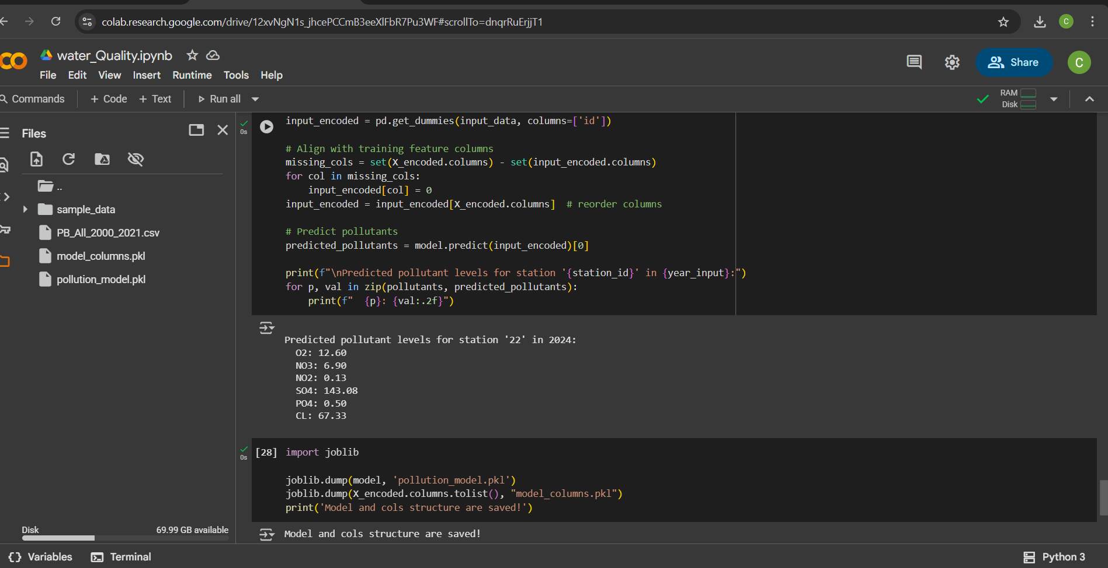
Screenshot of Output:

Slide 8
Conclusion:
Successfully predicted multiple water quality indicators
Achieved acceptable R² scores across all parameters
Shows potential for real-world use in monitoring water pollution
Internship enhanced understanding of ML for environmental applications

